Slide 1
Assessment of Breast Density via
Supervised and Unsupervised Algorithms
Peter Chang
Chanon Chantaduly
Su Kara
Trevor Reutershan
Chloe Zheng
CAIDM, UCI
Notes:
Su will start the presentation.

Slide 2
U-Net Segmentation
Notes:
Su will explain how a supervised U-Net algorithm is trained on MRIs for FGT and breast segmentation.

Slide 3
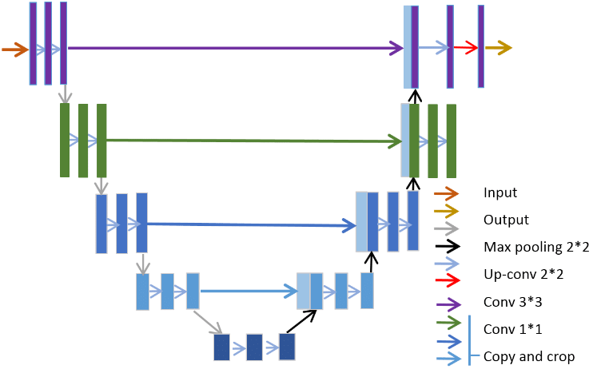
U-Net Architecture
input image
output mask

Slide 4
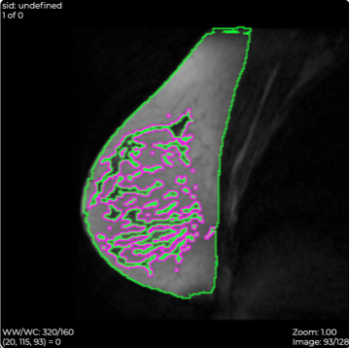
U-Net Performance
Input:
238 individual patient MRIs
Uniform (128, 256, 256) matrix
30,464 2D images
Dice scores:
Breast: 0.92
FGT: 0.78
Output:
FGT/breast ratio as ground-truth
FGT (pink) and breast (green) segments

Slide 5
Convolutional Neural Networks (CNN)
Notes:
Chloe will explain how a supervised CNN algorithm is trained on mammograms corresponding to the same patients with MRIs by using the ground-truth ratios generated by U-Net.

Slide 6
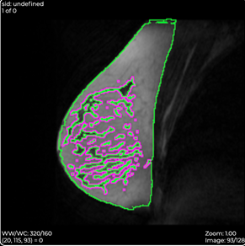
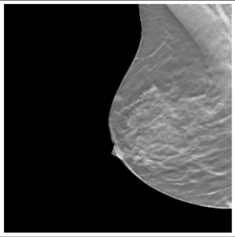
MRIs to Mammograms
MRI
Mammogram
Use FGT segmentation tool to predict density
GT = 0.3847

Slide 7
CNN Architecture for Linear Regression
1x1
Input = 256x256
128@2x2
112@4x4
80@8x8
Kernel: 3x3
Padding: same
64@16x16
Each layer:
2 conv1 block- no strides
1 conv2 block - 2x2 strides
Each Block:
Batch Norm
LeakyRelu
48@32x32
36@64x64
16@128x128

Slide 8
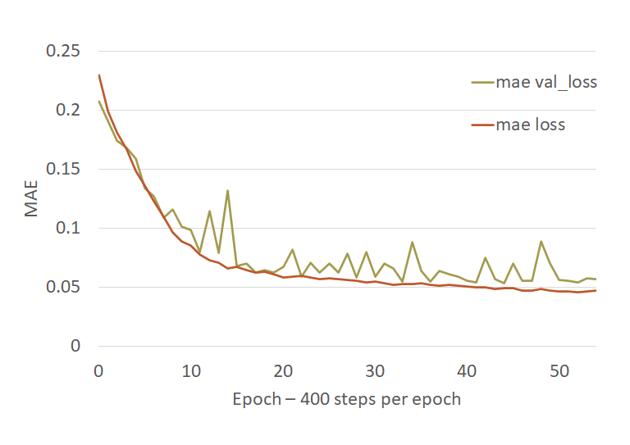
Initial Performance
LR = .0005
Batch Size = 12
Implemented EarlyStopping
Mean Absolute Error = 0.04-0.05

Slide 9
Experiments
Learning Rate tuning
Starting Learning Rate
LR Scheduler
ReduceLRon Plateau
Hyperparameters
L1/L2 regularizer
Dropout
Batch Size
Other Adjustments
Scaling the ground truth
Removing Activation Function
EarlyStopping vs Defining # of epochs

Slide 10
Experiments
Learning Rate tuning
Starting Learning Rate
LR Scheduler
ReduceLRon Plateau
Hyperparameters
L1/L2 regularizer
Dropout
Batch Size
Other Adjustments
Scaling the ground truth
Remove Activation Function
EarlyStopping vs Defining # of epochs

Slide 11

Best Performance
LR = .0005
Batch Size = 12
LR Scheduler: 1% decay rate every epoch
100 steps per epoch, 400 epochs
Scaled the ground truth values [0.0-0.4] => [0.0-1.0]
Removed sigmoid activation function
L2 regularizer = .01
Best MAE loss: 0.025
GT scaled by 2.5x
0.3847 => 0.9618

Slide 12
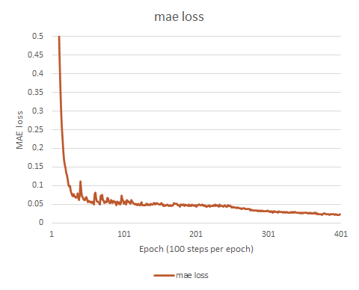
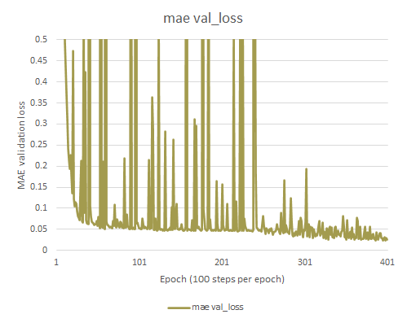
Remaining Issues...
Ideas! Adjust LR Scheduler and/or starting LR

Slide 13
Densely Connected Convolutional Networks (DenseNet)
Notes:
Trevor will explain how a supervised DenseNet algorithm is trained on mammograms corresponding to the same patients with MRIs by using the ground-truth ratios generated by U-Net.

Slide 14
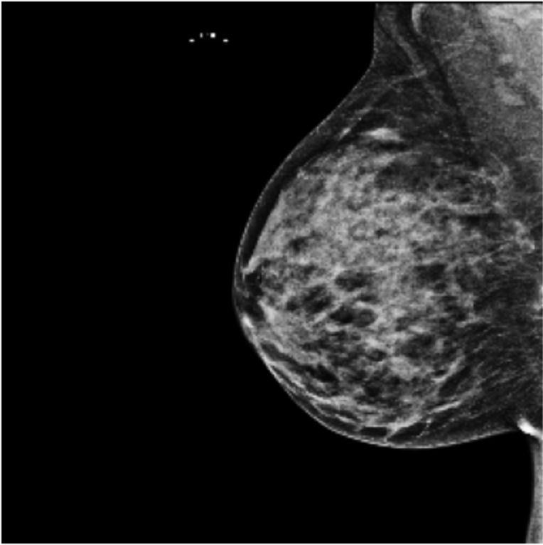

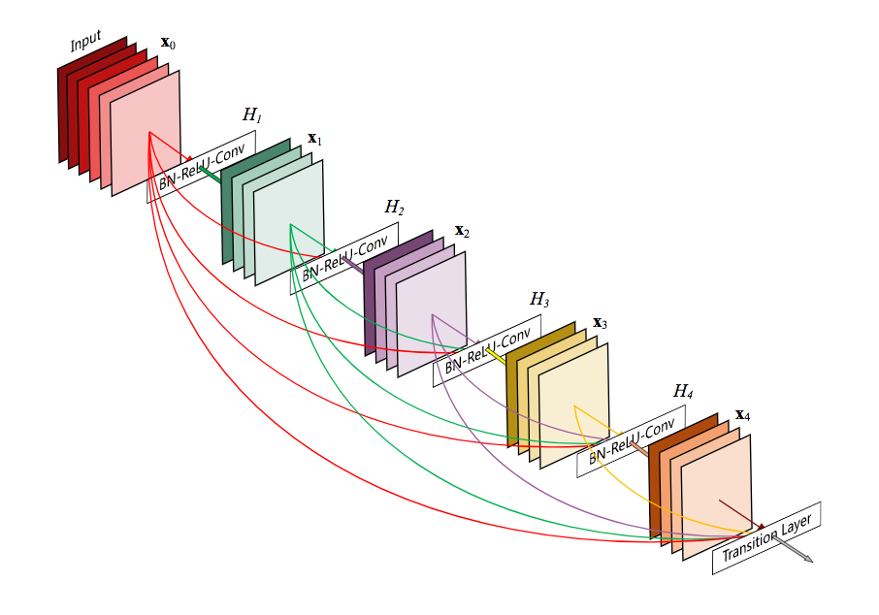
DenseNet Architecture
Input
Dense Block 1
Dense Block 2
Conv
Transition Layer
Transition Layer
Dense Block
…
Prediction
Dense Block n
FGT / Breast
Activation
Pooling

Slide 15
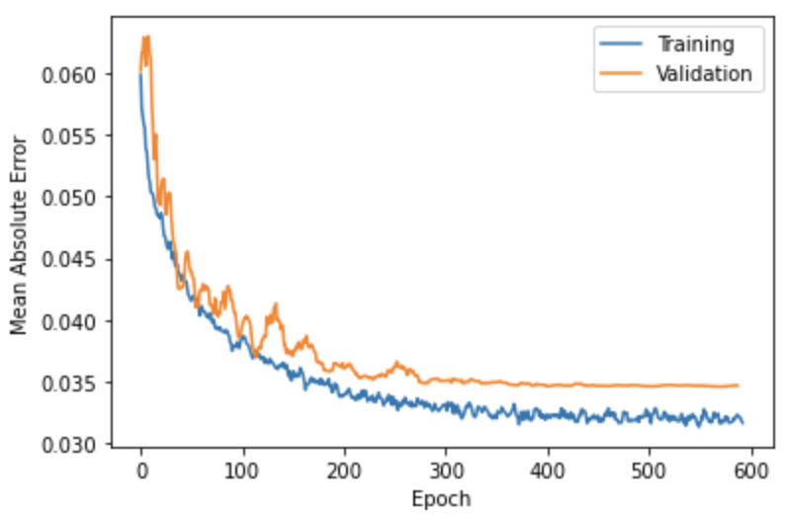
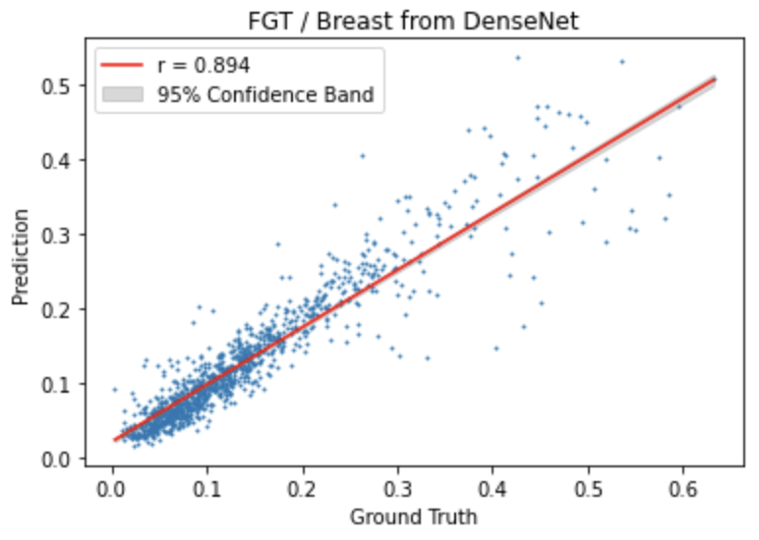
DenseNet Regression Parameters and Results
3 dense blocks without bottleneck
4 dense blocks with transition
Growth rate increased
Bottleneck 2 * growth rate
Only 3 layers per dense block
Loss Function - Huber
LR scheduling after n epochs
MAE = 0.0345, MAPE = 30%

Slide 16
Variational Auto-Encoders (VAE)
Notes:
Su will explain how an unsupervised VAE algorithm is trained on mammograms corresponding to the same patients with MRIs by using the ground-truth ratios generated by U-Net.

Slide 17
VAE Architecture
mean vector
latent matrix
16x16
input image
512x512
encoder
std dev
vector
decoder
output image
512x512
sampler

Slide 18
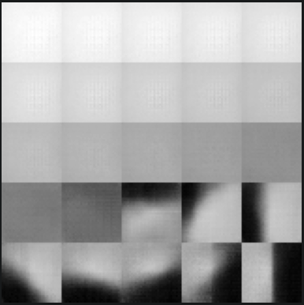
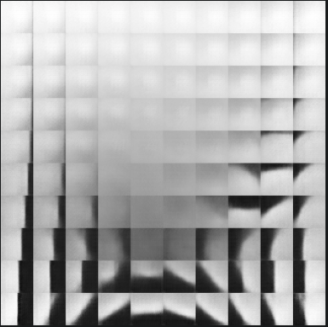
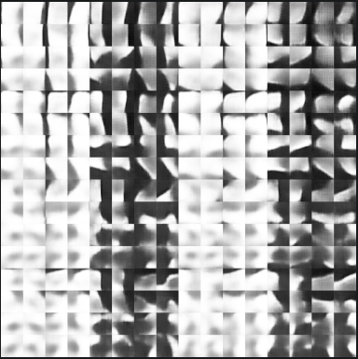
Decoder Prediction
1 feature
2 features
8 features

Slide 19
Process Workflow
Run encoder prediction on a 512x512 input image
Generate a 16x16 latent feature matrix for a patch shape of 32x32
Clean up latent feature matrix by removing predictions outside the breast
Collapse latent feature matrix into mean, variance, and weighted mean
Correlate them with the ground-truth FGT/breast ratio from U-Net

Slide 20
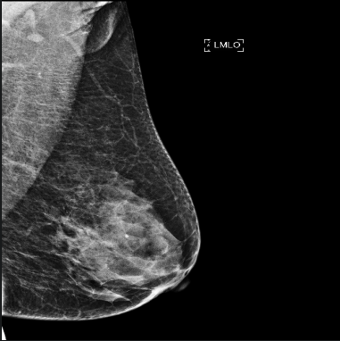
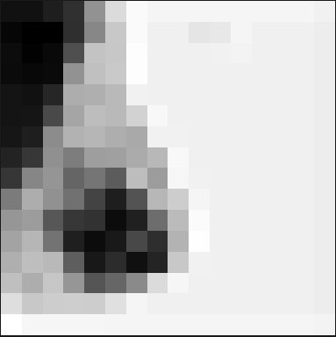
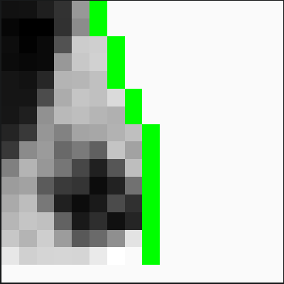
Encoder Prediction (1 feature)
original image
latent matrix
masked breast

Slide 21
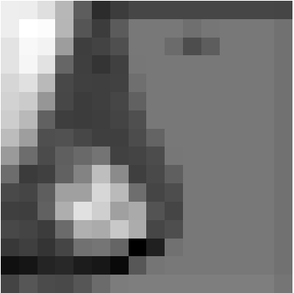
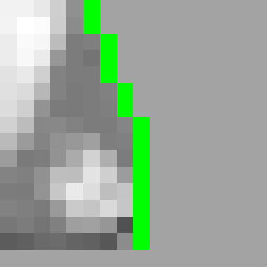
Encoder Prediction (2 features)
original image
latent matrix
masked breast

Slide 22
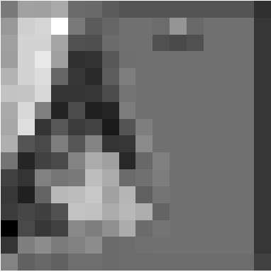
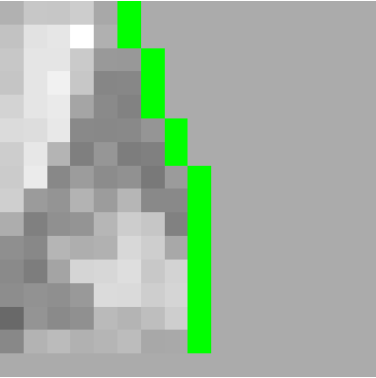
Encoder Prediction (10 features)
original image
latent matrix
masked breast

Slide 23
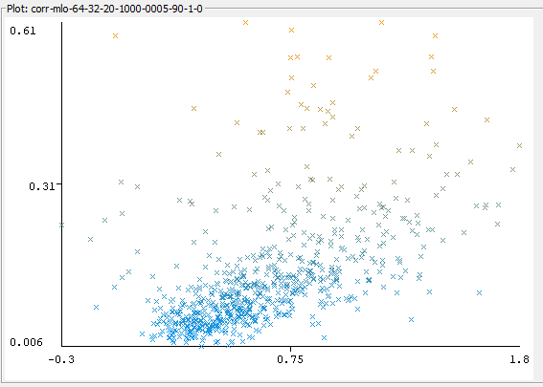
Results (1 feature)
Single variable linear regression:
Correlation: 0.53
gt = 0.17wm + 0.03
Mean abs error: 0.06
Multi-variable linear regression:
Correlation: 0.56
gt = 0.17wm - 0.18mean + 0.08
Mean abs error: 0.06

Slide 24
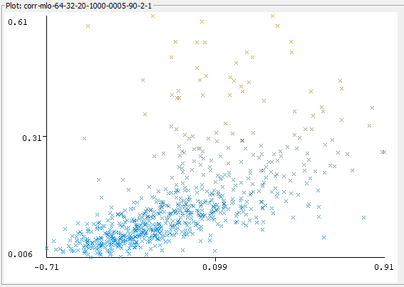
Results (2 features)
Single variable linear regression:
Correlation: 0.59
gt = 0.21wm + 0.15
Mean abs error: 0.06
Multi-variable linear regression:
Correlation: 0.63
gt = 0.18wm + 0.14mean - 0.11var + 0.22
Mean abs error: 0.06

Slide 25
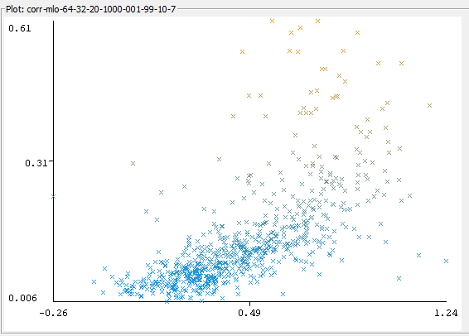
Results (10 features)
Single variable linear regression:
Correlation: 0.66
gt = 0.29wm
Mean abs error: 0.05
Multi-variable linear regression:
Correlation: 0.66
gt = 0.28wm - 0.07mean - 0.07var + 0.05
Mean abs error: 0.05

Slide 26
Conclusion
VAE can be used as an unsupervised approach
More features provide higher correlation for weighted mean
Trade-off between more features and multi-variable regression
Correlation can be improved by considering:
More features to find saturation
Non-linear regression models
A better breast masking approach
A filter on non-fgt portions for mlo

